Slide 1


MINI PROJECT SEMINAR
ON
“Li-Fi DATA TRANSFER SYSTEM”
BY
P MOURYA DEEPAK
V REEMA RANI
G AMARNATH
MENTOR: Mr. A. BALA RAJU M.E., B.TECH, PH.D.*
DEPARTMENT OF ELECTRONICS AND COMMUNICATION ENGINEERING

Slide 2
AIM OF THE PROJEECT
To create a new class of high intensity light source of solid-state design bringing clean lighting solutions to general and specialty lighting. With energy efficiency, long useful lifetime, full spectrum and dimming, LI-FI lighting applications work better compared to conventional approaches. This technology brief describes the general construction of LI-FI lighting systems and the basic technology building blocks behind their function.

Slide 3
INTRODUCTION
Li-Fi technology utilizes LED’s for transmitting data. It is subsidiary of optical remote communication technology utilizing light from Led to convey rapid communication.
So here we develop a data transfer system that uses the Li Fi technology. This system serves the following advantages: •High Speed Data Transfer •No Wires Needed •Reliable Communication with No Data Loss •Low Cost of Developing the System
The system allows us to use LI-FI medium for data transfer. We make use of a Li-Fi transmitter android app to demonstrate this concept.
The app converts written text message into light flash data for transmission. The user needs to start the app and type the message to be transmitted.
App controls the mobile phone flashlight to transmit the message. The atmega microcontroller decodes and processes the message sent and then displays it over an LCD display to complete the data transmission.

Slide 4
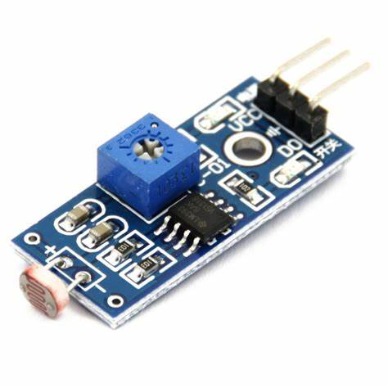
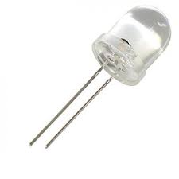
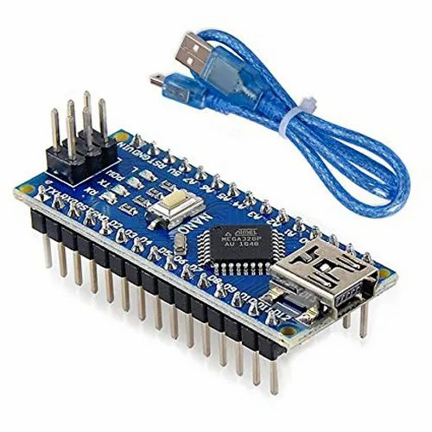
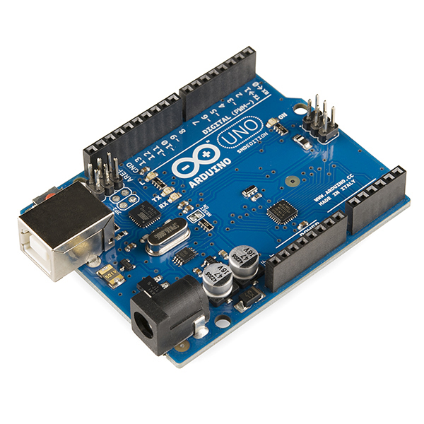
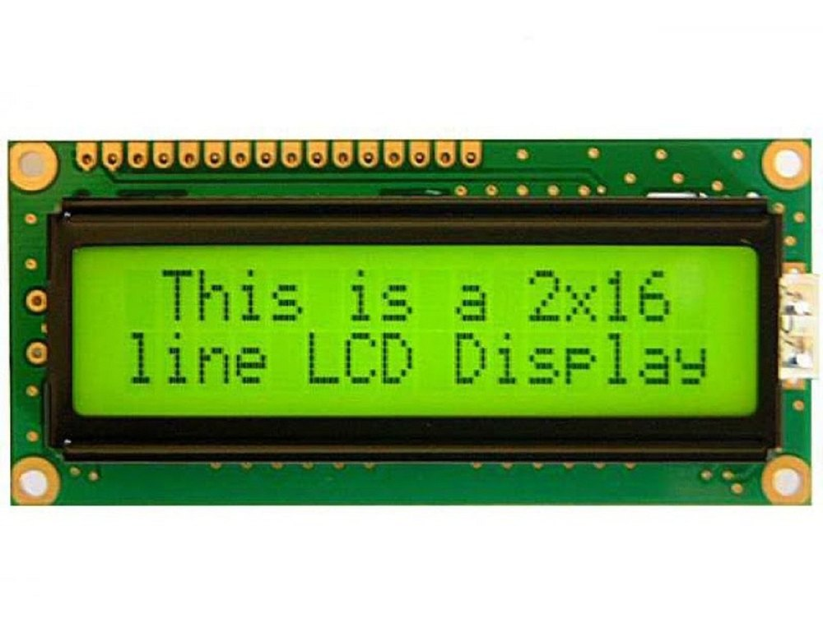
COMPONENTS
ARDUINO UNO & nano
LDR Sensor
Regulator Circuitry
LED’s
Bread Board
Resistors
Cables and Connectors
Wires
LCD Display

Slide 5
SOFTWARE
C language is use to create user interface to control Arduino. The serial communication is established between pc and Arduino.
Arduino IDE 2.0.2 application is used to transfer the signal from computer to microcontroller to perform the operation for which it is made.

Slide 6
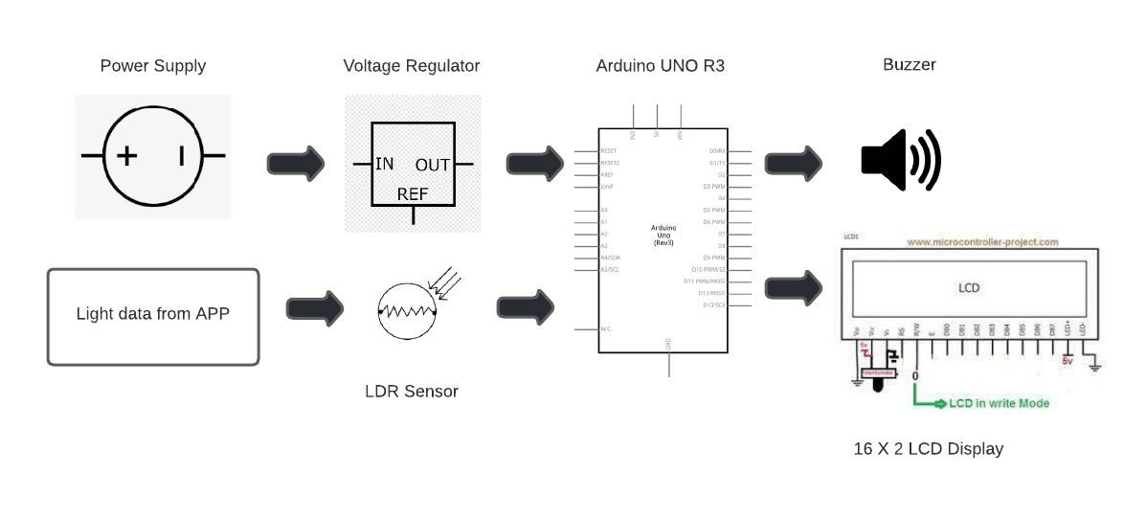
BLOCK DIAGRAM
TRANSMITTER

Slide 7
METHODOLOGY
CODE FROM TRANSMITTER
ARDUINO RECIEVES DATA FROM SERIAL MONITOR
DATA TRANSMISSION USING LED
THE DATA IS BEING TRANSMITTED TO LCD DISPLAY
ARDUINO AT THE RECEIVER SIDE DECODES THE DATA
LDR SENSOR RECIEVES THE DATA VIA LIGHT
DATA IS BEING DISPLAYED AT THE RECEIVER SIDE
LCD DISPLAYS THE DATA

Slide 8
WORKFLOW OF THE PROJECT
CODE FROM TRANSMITTER : The code at the transmitter part is being uploaded to the Arduino.
ARDUINO RECIEVES DATA FROM SERIAL MONITOR : we send the data using serial monitor to the Arduino.
DATA TRANSMISSION USING LED : LED blinks and transmits the data using light.
LDR SENSOR RECIEVES THE DATA VIA LIGHT: based on the intensity of the light ,LDR senses.
ARDUINO AT THE RECEIVER SIDE DECODES THE DATA : the data which is being received at the Arduino detects the data.
DATA IS BEING TRANSMITTED TO LCD DISPLAY : the output from the digital pins is displayed on the LCD display.

Slide 9
LITERATURE REVIEW
In order to respond to the increasing demand of capacity and bandwidth caused by the high number of wireless applications and users, LiFi technology was introduced. It uses the visible light spectrum instead of the radio spectrum to transmit data wirelessly through the illumination of LED lamps. The main advantage of this technology is to provide wireless communications with high data rates.
Due to the great features of LiFi, more applications and everyday life devices will adopt this technology in the future. However, Because of its limitations, it may not totally replace RF technology, but they will work collaboratively to achieve a better performance.

Slide 10
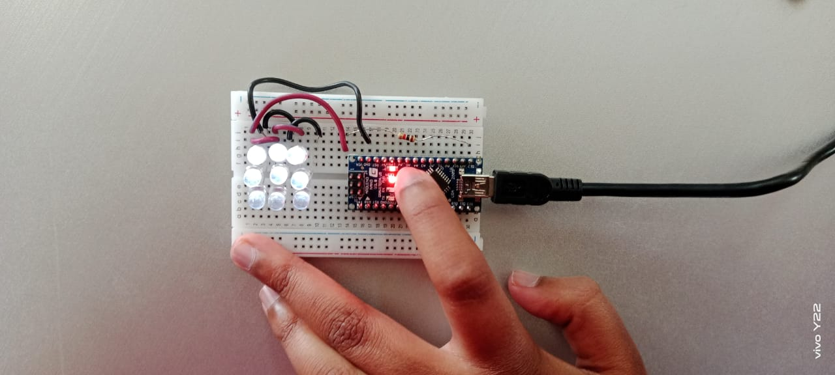
RESULTS
Fig 1 : data transmission using LED ( transmitter kit )

Slide 11
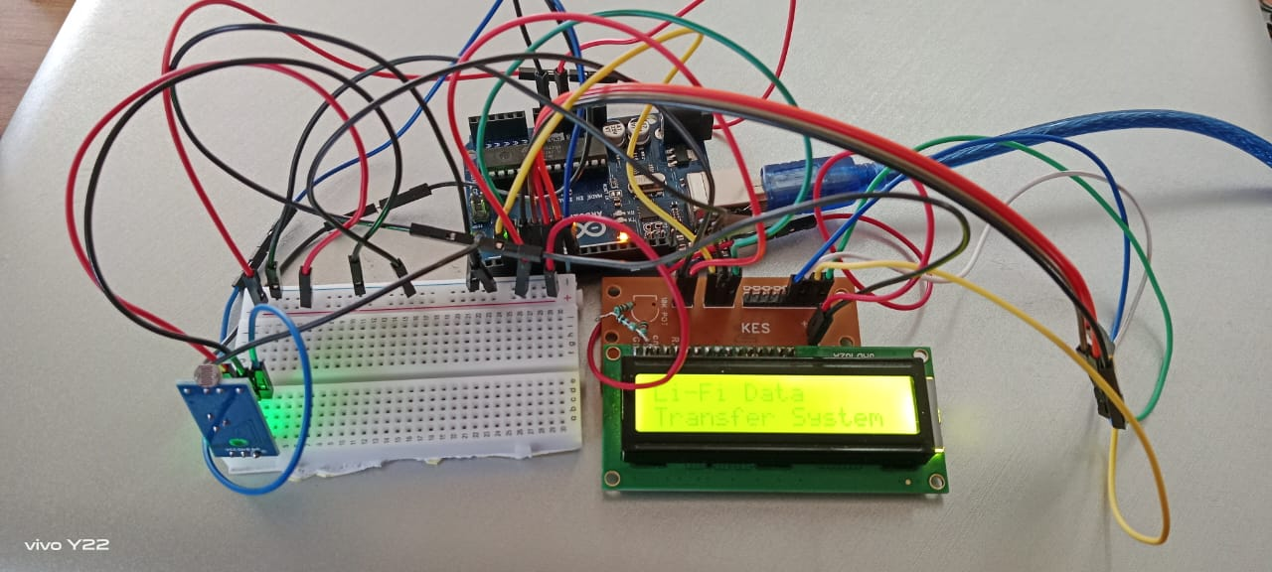
RESULTS
Fig 2 : Data reception at the receiver end

Slide 12
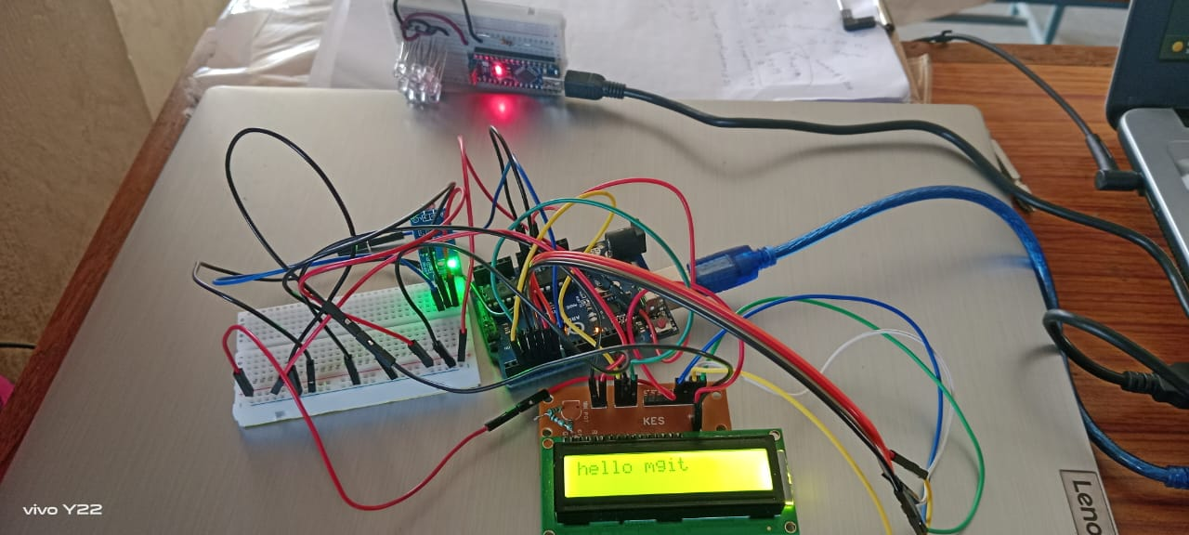
RESULTS
Fig 3 : data from the receiver is displayed at the receiver’s LCD display using light.

Slide 13
APPLICATIONS
Li-Fi technology in Hospitals
Li-Fi in the Workplace
Secured connection data transfer
Speed data transfer
Li-Fi and Industry
Li-Fi and Military
Communication Underwater
Communication in dangerous Environments or In Sensitive regions

Slide 14
CONCLUSION
Let us summarize few important points.
Advantages of LiFi over wifi:• Higher bandwidth • better efficiency • better connectivity• greater security • higher speed and • low cost of lighting units.
Disadvantages of LiFi over wifi: • LOS communication between transmitter and receiver • Required costly devices for better performance • Presence of light is a must • Shorter range than wifi • Interference from other light sources • Blockage due to opaque obstacles and so on.

Slide 15
THANK YOU

